Slide 1
Module – 3 MANIPULATING STRINGS

Slide 2
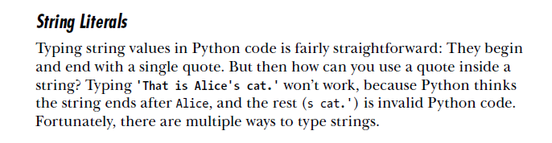
Working with Strings

Slide 3
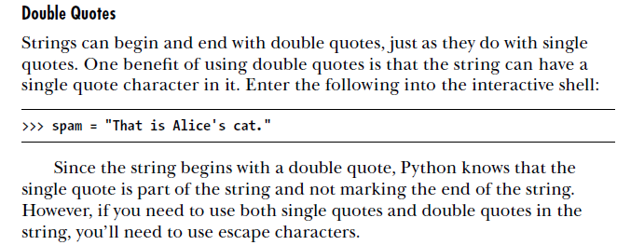

Slide 4
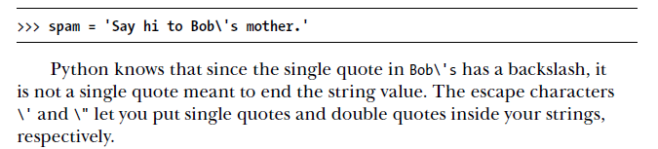
Escape Characters
An escape character lets you use characters that are otherwise impossible to put into a string. An escape character consists of a backslash (\) followed by the character you want to add to the string.

Slide 5
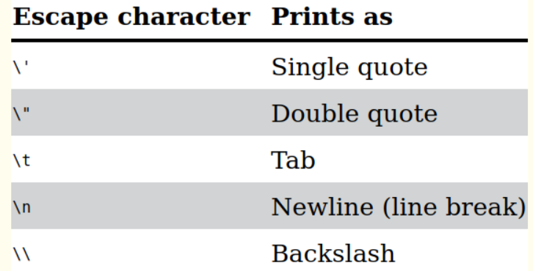
String Literals
Can we use a quote inside a string? 'That is Alice's cat.'
Double quotes "That is Alice's cat."
Escape character 'Say hi to Bob\'s mother.'

Slide 6
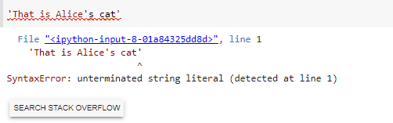

Slide 7
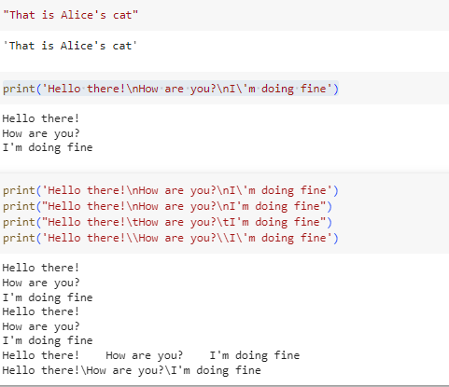

Slide 8
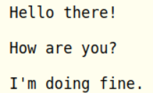


print( ) using escape characters & raw strings
print("Hello there!\nHow are you?\nI\'m doing fine.")
A raw string completely ignores all escape characters and prints any backslash that appears in the string.
print(r'That is Carol\'s cat.')

Slide 9
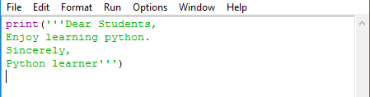
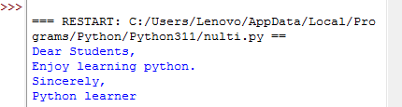
Multiline string with three single quotes
A multiline string in Python begins and ends with either three single quotes or three double quotes. Any quotes, tabs, or newlines in between the “triple quotes” are considered part of the string.
Python’s indentation rules for blocks do not apply to lines inside a multiline string.

Slide 10
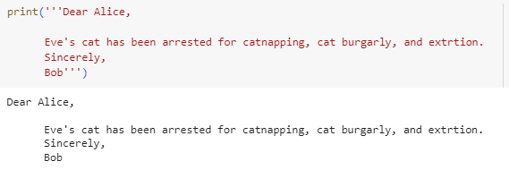
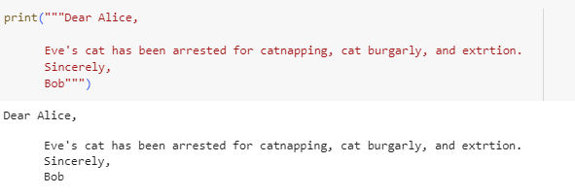
# Multiline string using single quote
# Multiline string using double quote

Slide 11
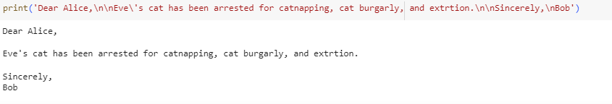
Without using multiline string

Slide 12
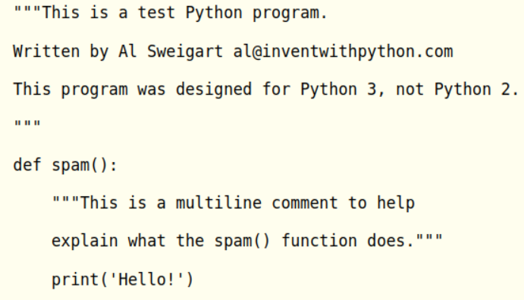
Multiline Comments
While the hash character (#) marks the beginning of a comment for the rest of the line, a multiline string is often used for comments that span multiple lines.

Slide 13

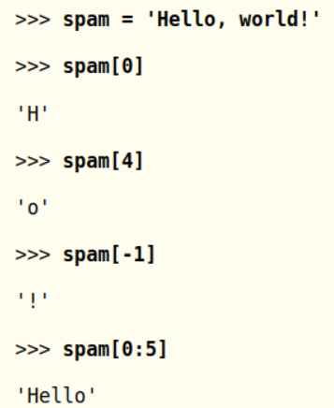
Indexing and Slicing Strings
'Hello, world!'
Each string value can be thought of as a list and each character in the string as an item with a corresponding index
-ve index count from the end

Slide 14
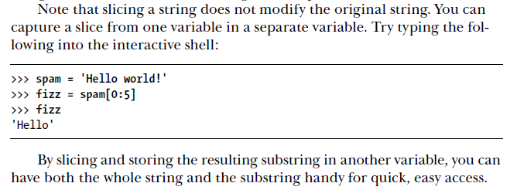
Slicing string

Slide 15
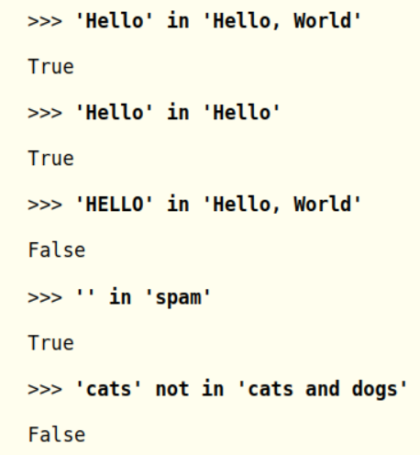
The in and not in Operators with Strings
The in and not in operators can be used with strings just like with list values.
An expression with two strings joined using in or not in will evaluate to a Boolean True or False.

Slide 16
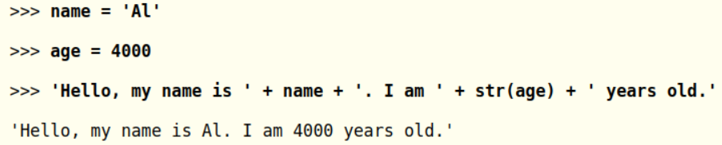
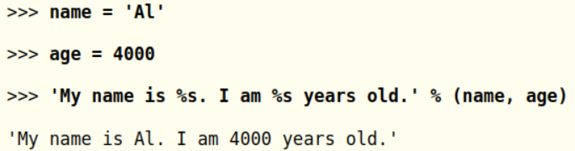
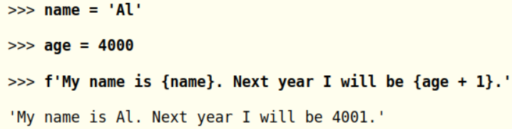
Putting Strings Inside Other Strings
string interpolation using %s
f-strings, which is similar to string interpolation except that braces are used instead of %s

Slide 17

Built-in methods for string manipulation

Slide 18
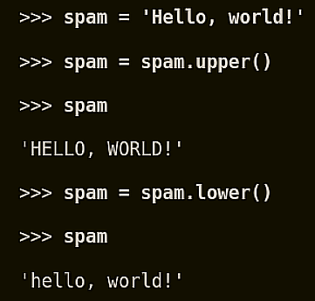
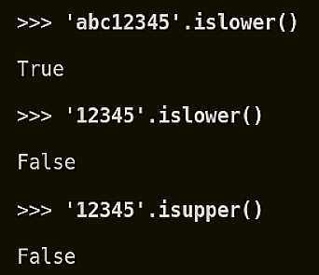
upper(), lower(), isupper(), and islower() Methods
Useful String Methods
The upper() and lower() string methods return a new string where all the
letters in the original string have been converted to uppercase or lowercase, respectively.

Slide 19
'abcABC'.islower()
False
'abcABC'.isupper()
False
'ABC'.isupper()
True
'1234ABC'.isupper()
True
'1234abc'.islower()
True

Slide 20
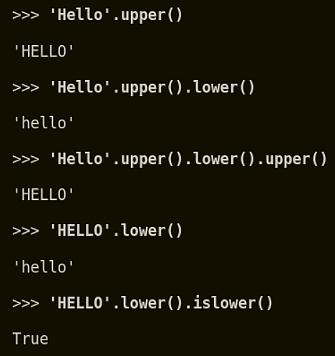
upper( ) and lower( ) chain
Since the upper() and lower() string methods themselves return strings, you can call string methods on those returned string values as well.

Slide 21
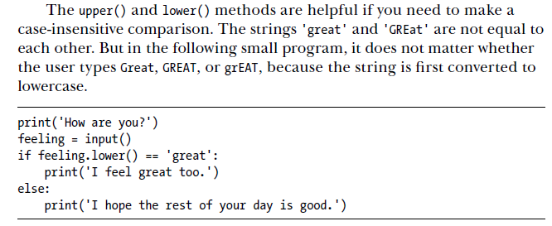
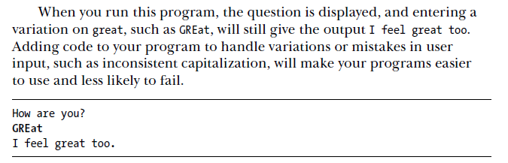

Slide 22
Nonletter characters in the string remain changed or unchanged
Asw: Unchanged
String methods do not change the string itself but return new string values.
If you want to change the original string , you have to call upper() and lower() on the string and then assign the new string to the variable where the original was stored.
spam='Hello world!'
spam.upper()
spam
Output:
Hello world!

Slide 23
Guess the output:
spam='Hello world!'
spam.upper()
spam
Output:
Hello world!
spam='Hello world!'
spam=spam.upper()
Spam
Output:
HELLO WORLD!
for i in range(2,2):
print(i)
Output:
It will not print anything
When do we use upper ()and lower() methods?
These methods are helpfull when you do a case-insensitive comparison.

Slide 24
isX() Methods
isalpha() Returns True if the string consists only of letters and isn’t blank
isalnum() Returns True if the string consists only of letters and numbers and is not blank
isdecimal() Returns True if the string consists only of numeric characters and is not blank
isspace() Returns True if the string consists only of spaces, tabs, and newlines and is not blank
istitle() Returns True if the string consists only of words that begin with an uppercase letter followed by only lowercase letters

Slide 25
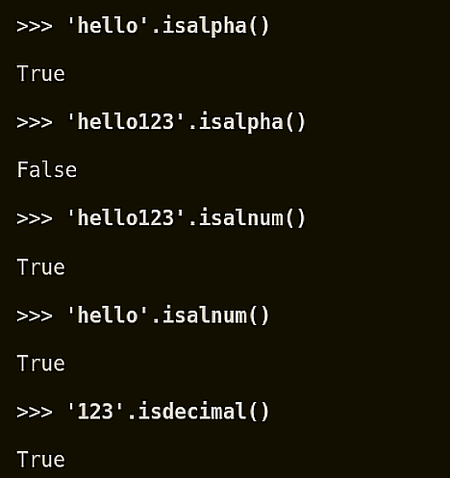
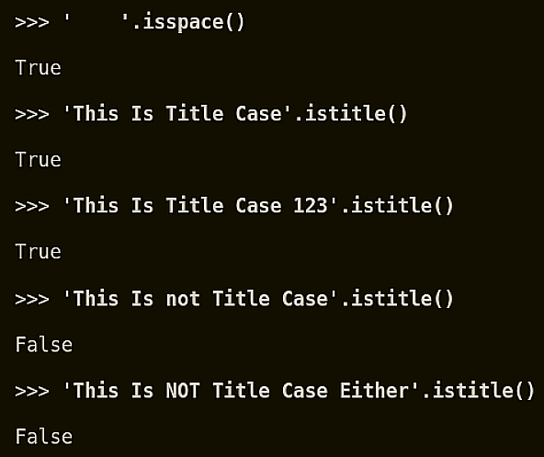
isX( ) examples

Slide 26
' '.isalpha()
False
'helloHello'.isalpha()
True
'hello123'.isalnum()
True
'01234'.isdecimal()
True
'01234c'.isdecimal()
False
'hello123!'.isalnum()
False
'123'.isalnum()
True
'abcAbc'.isalnum()
True
'This is String Methods'.istitle()
False
'This Is String Methods'.istitle()
True
'This Is String METHODS'.istitle()
False

Slide 27
‘ ’isspace()
True
‘\n’.isspace()
True
‘ My name ’.isspace()
False
‘ \n ’.isspace()
True
‘ \n hi ’.isspace()
False

Slide 28
The isX methods are helpful when you need to validate user input.
Example:
The following program repeatedly asks user for their age and a password until they provide valid input.

Slide 29
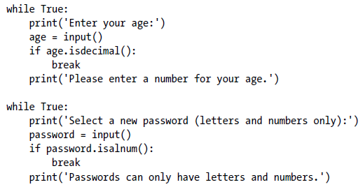
In the first while loop, we ask the user for their age and store their input in age. If age is a valid (decimal) value, we break out of this first while loop and move on to the second, which asks for a password. Otherwise, we inform the user that they need to enter a number and again ask them to enter their age.
In the second while loop, we ask for a password, store the user’s input in password, and break out of the loop if the input was alphanumeric.
If it wasn’t, we’re not satisfied so we tell the user the password needs to be alphanumeric and again ask them to enter a password.

Slide 30
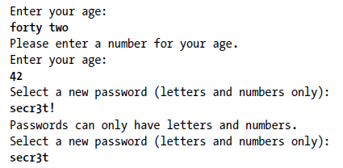
Calling isdecimal() and isalnum() on variables, we’re able to test whether the values stored in those variables are decimal or not, alphanumeric or not. Here, these tests help us reject the input forty two and accept 42, andreject secr3t! and accept secr3t.

Slide 31
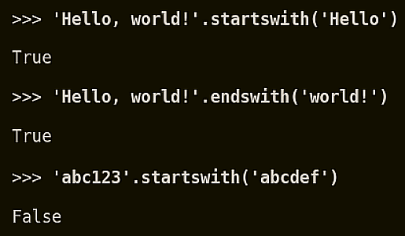
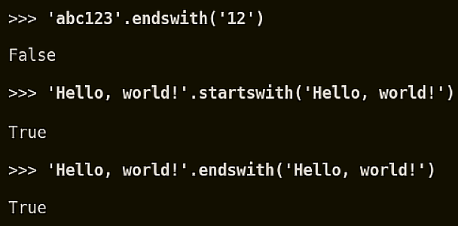
startswith() and endswith()
The startswith() and endswith() methods return True if the string value they are called on begins or ends (respectively) with the string passed to the method; otherwise, they return False.

Slide 32
These methods are useful alternatives to the ‘==‘ operator.
'Hello World!'.startswith()
Error
'Hello World!'.startswith('Hello')
True
'Hello World!'.startswith('HEllo')
False
'Hello World!'.endswith('Hello')
False
'Hello World!'.endswith(‘World')
False
'My name is smitha'.endswith('smitha')
True

Slide 33
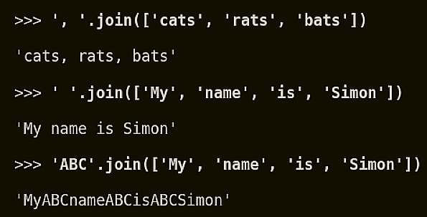
join() method
The join() method is useful when you have a list of strings that need to be joined together into a single string value.
This method is called on a string and passed a list of string

Slide 34
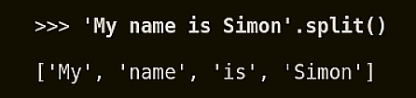
split ( ) method
It does opposite to join()
It is called on a string value and return a list of strings.
By default, the string 'My name is Simon' is split wherever whitespace characters such as the space, tab, or newline characters are found.
These whitespace characters are not included in the strings in the returned list.

Slide 35
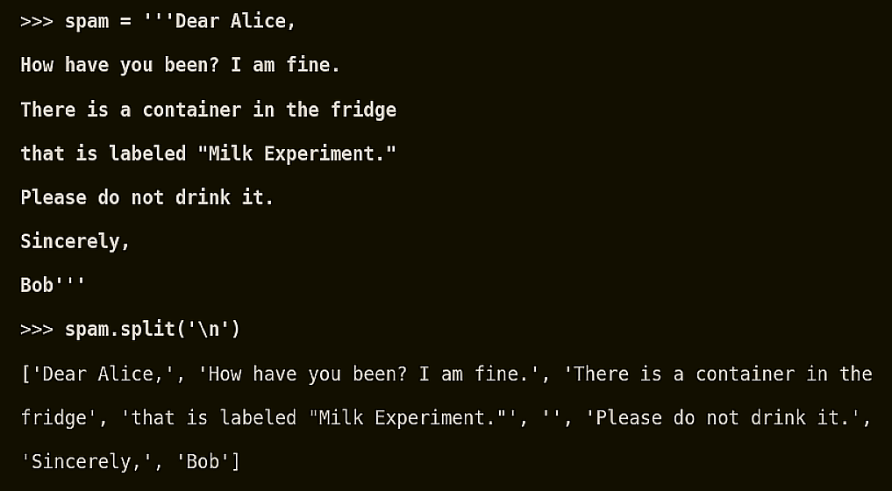
split ( ) using a delimiter
A common use of split() is to split a multiline string along the newline characters.

Slide 36
'My name is simon'.split('m')
Output:
['My na', 'e is si', 'on‘]
spam='''Dear Alice
How are you doing?
Please take care of your health'''
spam.split('\n')
Output:
['Dear Alice', 'How are you doing?', 'Please take care of your health']
spam='''Dear Alice
How are you doing?
Please take care of your health'''
spam.split()
Output:
['Dear', 'Alice', 'How', 'are', 'you', 'doing?', 'Please', 'take', 'care', 'of', 'your', 'health']

Slide 37
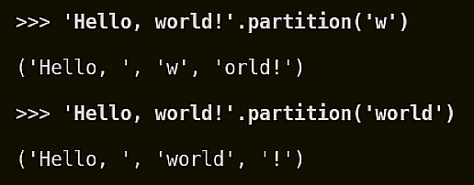
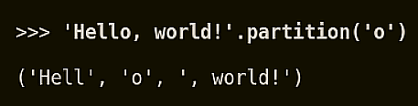
Splitting Strings with the partition() Method
If the separator string you pass to partition() occurs multiple times in the string that partition() calls on, the method splits the string only on the first occurrence:

Slide 38
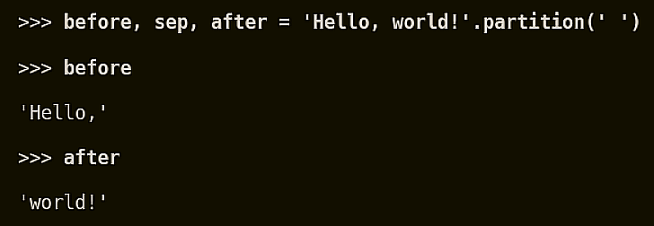
Using partition( ) for multiple assignment

Slide 39
>>>fruit,sep,vegetable='Apple Carrot'.partition(‘ ')
>>>vegetable
‘Carrot’
>>>fruit
‘Apple’

Slide 40
Justifying Text
rjust()
ljust()
center()

Slide 41
Justifying Text with rjust(), ljust(), and center()
The rjust() and ljust() string methods return a padded version of the string they are called on, with spaces inserted to justify the text.
The first argument to both methods is an integer length for the justified string.
An optional second argument to rjust() and ljust() will specify a fill character other than a space character.

Slide 42
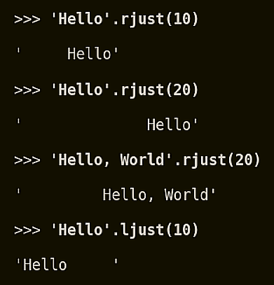
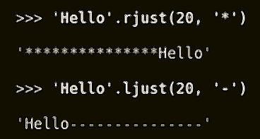
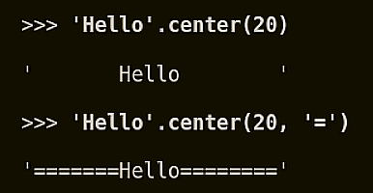
Justifying text
'Hello'.rjust(10) says that we want to right-justify 'Hello' in a string of total length 10. 'Hello' is five characters, so five spaces will be added to its left, giving us a string of 10 characters with 'Hello' justified right.
The center() string method works like ljust() and rjust() but centers the text rather than justifying it to the left or right.

Slide 43
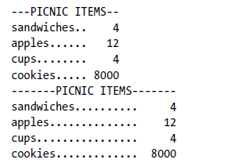


The picnic items are displayed twice.The first time the left column is 12 characters wide, and the right column is 5 characters wide. The second time they are 20 and 6 characters wide, respectively.
In this program, we define a printPicnic() method that will take in a dictionary of information and use center(), ljust(), and rjust() to display that information in a neatly aligned table-like format.
In picnicItems, we have 4 sandwiches, 12 apples, 4 cups, and 8000 cookies. We want to organize this information into two columns, with the name of the item on the left and the quantity on the right.

Slide 44
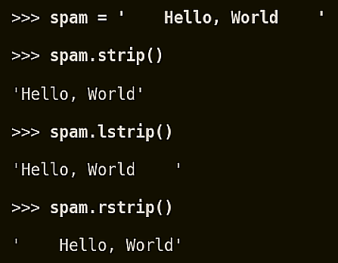
Removing Whitespace with the strip(), rstrip(), and lstrip() Methods
whitespace characters (space, tab, and newline)
The strip() string method will return a new string without any whitespace characters at the beginning or end.
The lstrip() and rstrip() methods
will remove whitespace characters from the left and right ends

Slide 45
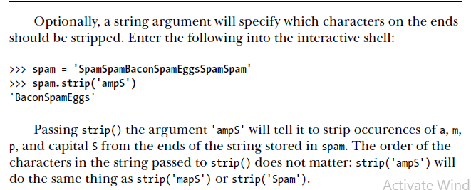

Slide 46
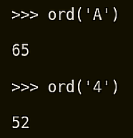

Numeric Values of Characters with the ord() and chr() Functions
Every text character has a corresponding numeric value called a Unicode code point. For example, the numeric code point is 65 for 'A'
The ord() function can be used to get the code point of a one-character string, and the chr() function to get the one-character string of an integer code point

Slide 47
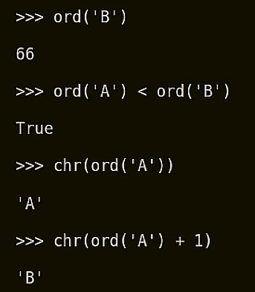
Ordering or mathematical operation on characters

Slide 48
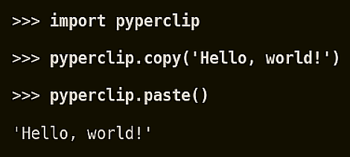
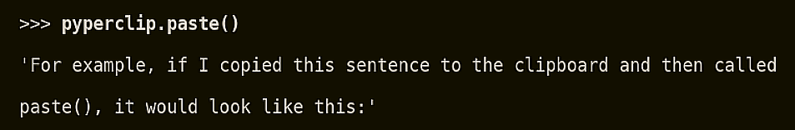
Copying and Pasting Strings with the pyperclip Module
The pyperclip module has copy() and paste() functions that can send text to and receive text from your computer’s clipboard. Sending the output of your program to the clipboard will make it easy to paste it to an email, word processor, or some other software.
NOTE: pyperclip module should be available in the local environment

Slide 49
Generate N prime number sequence
list=[]
for i in range(2,101):
flag=0
for j in range(2,i):
if i%j==0:
flag=1
break
if flag==0:
list.append(i)
print('The prime numbers are:',list)
Output:
The prime numbers are: [2, 3, 5, 7, 11, 13, 17, 19, 23, 29, 31, 37, 41, 43, 47, 53, 59, 61, 67, 71, 73, 79, 83, 89, 97]

Slide 50
Project

Slide 51
File Handling in Python
Reading and Writing Files

Slide 52
Files and File Paths
A file has two key properties: a filename (usually written as one word) and
a path.
The path specifies the location of a file on the computer. For example:
there is a file on my Windows 7 laptop with the filename projects.docx in the
path C:\Users\asweigart\Documents.
The part of the filename after the last period is called the file’s extension and tells you a file’s type.

Slide 53
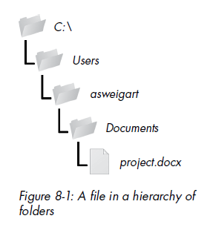
project.docx is a Word document, and Users, asweigart, and Documents all refer to folders/ directories
Folders can contain files and other folders.
For example, project.docx is in the Documents folder, which is inside the asweigart folder, which is inside the Users folder.
The C:\ part of the path is the root folder, which contains all other folders. On Windows, the root folder is named C:\ and is also called the C: drive.
On OS X and Linux, the root folder is /.

Slide 54
Backslash on Windows and Forward Slash on OS X and Linux
On Windows, paths are written using backslashes (\) as the separator between folder names.
OS X and Linux, however, use the forward slash (/) as their path separator.
If you want your programs to work on all operating systems, you will have to write your Python scripts to handle both cases.
This is simple to do with the os.path.join() function.
If you pass it the string values of individual file and folder names in your path,
os.path.join() will return a string with a file path using the correct path separators.

Slide 55



os.path.join('usr', 'bin', 'spam') returned 'usr\\bin\\spam‘ in windows.
If I had called this function on OS X or Linux, the
string would have been 'usr/bin/spam'.
The os.path.join() function is helpful if you need to create strings for filenames.
example joins names from a list of filenames to the end of a folder’s name

Slide 56
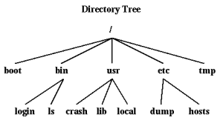
Filesystem in UNIX

Slide 57
File handling commands in UNIX
pwd : present working directory
ls : list files
Home Directory (/)
cd : change directory
cd / : change to root directory
mkdir : make directory / create directory
Copy and move commands: cp and mv

Slide 58
pathlib module in python
A built-in module called pathlib is available in python 3.4 onwards for handling files.
File management includes creating, moving, copying, and deleting files and directories, checking if a file or directory exists,and so on.

Slide 59
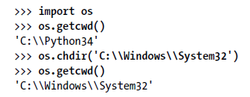
The Current Working Directory
Every program that runs on your computer has a current working directory or cwd.
Any filenames or paths that do not begin with the root folder are assumed to be under the current working directory.
You can get the current working directory as a string value with the os.getcwd() function and change it with os.chdir().

Slide 60
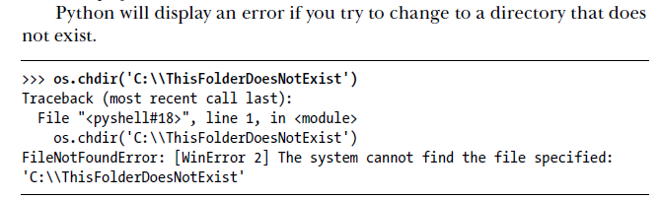

Slide 61
Absolute vs. Relative Paths
There are two ways to specify a file path:
An absolute path, which always begins with the root folder
A relative path, which is relative to the program’s current working directory
There are also the dot (.) and dot-dot (..) folders. These are not real folders but special names that can be used in a path.
A single period (“dot”) for a folder name is shorthand for “this directory.” Two periods (“dot-dot”) means “the parent folder.”

Slide 62



(dot) and (dot dot) operators
. (this directory)
.. (parent directory)
Demo in Terminal

Slide 63


Slide 64


Creating New Folders with os.makedirs()
This will create not just the C:\delicious folder but also a walnut folder inside C:\delicious and a waffles folder inside C:\delicious\walnut. That is,
os.makedirs() will create any necessary intermediate folders in order to ensure that the full path exists.

Slide 65


Slide 66
Handling Absolute and Relative Paths
The os.path module provides functions for returning the absolute path of a relative path and for checking whether a given path is an absolute path.
Calling os.path.abspath(path) will return a string of the absolute path of the argument. This is an easy way to convert a relative path into an absolute one.
Calling os.path.isabs(path) will return True if the argument is an absolute path and False if it is a relative path.
Calling os.path.relpath(path, start) will return a string of a relative path from the start path to path. If start is not provided, the current working directory is used as the start path.

Slide 67




Slide 68

Finding File Sizes and Folder Contents
Calling os.path.getsize(path) will return the size in bytes of the file in the path argument.
Calling os.listdir(path) will return a list of filename strings for each file in the path argument

Slide 69

dirname and basename

Slide 70

os.path.split()
If you need a path’s dir name and base name together, you can just call os.path.split() to get a tuple value with these two strings, like so:

Slide 71


Slide 72

os.path.sep()

Slide 73
Finding File Sizes and Folder Contents
• Calling os.path.getsize(path) will return the size in bytes of the file in the path argument.
• Calling os.listdir(path) will return a list of filename strings for each file in the path argument. (Note that this function is in the os module, not os.path.)

Slide 74

To find the total size of all the files in this directory, we can use os.path.getsize() and os.listdir() together.

Slide 75
Checking Path Validity
Calling os.path.exists(path) returns True if the path exists or returns False if it doesn’t exist.
Calling os.path.isfile(path) returns True if the path exists and is a file, or returns False otherwise.
Calling os.path.isdir(path) returns True if the path exists and is a directory, or returns False otherwise.

Slide 76


Slide 77


Slide 78
The File Reading/Writing Process
The functions covered in the next few sections will apply to plaintext files.
Plaintext files contain only basic text characters and do not include font, size, or color information.
Text files with the .txt extension or Python script files with the .py extension are examples of plaintext files.
Binary files are all other file types, such as word processing documents, PDFs, images, spreadsheets, and executable programs. If you open a binary file in Notepad or TextEdit, it will look like scrambled nonsense, like in

Slide 79
Three steps to reading or writing files in Python
Call the open() function to return a File object.
Call the read() or write() method on the File object.
Close the file by calling the close() method on the File object.

Slide 80

Binary Files
Opening a calc.exe in windows using notepad

Slide 81
Opening Files with the open() Function
To open a file with the open() function, you pass it a string path indicating the file you want to open; it can be either an absolute or relative path. The open() function returns a File object.
open('/Users/asweigart/hello.txt', 'r')

Slide 82


Reading the Contents of Files
If you want to read the entire contents of a file as a string value, use the File object’s read()
method.
use the readlines() method to get a list of string values from the file, one string for each line of text.

Slide 83


Slide 84




To read the content of the file line by line there are 3 commands:

Slide 85

Writing to Files
Similar to how the print() function “writes” strings to the screen.
Pass 'w' as the second argument to open() to open the file in write mode.
Append mode, on the other hand, will append text to the end of the existing file. Pass 'a' as the second argument to open() to open the file in append mode.

Slide 86





Before
After
Before
After

Slide 87

5. Develop a program to print 10 most frequently appearing words in a text file. [Hint: Use dictionary with distinct words and their frequency of occurrences. Sort the dictionary in the reverse order of frequency and display dictionary slice of first 10 items]

Slide 88
OUTPUT

